Slide 1

Project 2
Iteration 3

Slide 2
Team member
Rabindra Gurung(30335729)
Nisha Prasai(30336119)
Pragyan Karkee(30356375)
Dependra Thapa(30335012)

Slide 3
Introduction – project overview
The website is for all international students as well as for IIBIT students.
Assist all international students for finding the rooms, job, social activities and local suburbs, events etc.
Help the students to make good relationships with others.
Maintain various group communications and also communication with admin using live chat.
Help to organize events, ceremonies, entertainment program for the user.

Slide 4
Our clients are the IIBIT international students.
Students are the important for us as a client.
We as a IIBIT students wanted to help other under going IIBIT students with their daily personal activities to avoid facing difficulties.
Clients will be easily able to use and login to our website.
Client details

Slide 5
Roles and responsibilities
Assistant Project Manager (Rabindra)
Project Manager(Nisha )
Lead Developer
( Pragyan)
Designer (Dipendra)
Tester/ Debugger(Pragyan)
Lead Analyst (Nisha)

Slide 6
Project specific – Domain specific and technical aspects
For creating website following coding will be using:
1. Programming Languages
Xampp
CSS
HTML
PHP
2. Database
My SQL

Slide 7
Iteration 1
US4 As a user, I want to have employment services and provide some information so that I can apply for the job which has opened for the job vacancy or staff needed.
US5 As a user, I want to create an account in this website so that I can get some updated information.
US6 As a user, I want to reset the password in the website.
US14 As a user, I want to rate the website so that students could know how good the website is.
US15 As a user, I want to provide the feedback section so that users can share their idea or problems so that we can improve in future.
US20 As an admin, I want to create a marketplace so that the students can sell their cars, books and furniture’s in low rate.
US 23 As an admin, I want to create a chat board so that they can ask everything they want through the chat board and chat where board replies automatically which will help to ask anytime.

Slide 8
Iteration 2
US7 As a user, I want to update/post my experience so that I can express my idea staying in abroad.
US8 As a user, I want to communicate with other students so that I can make some new friends.
US16 As a user, I want to share or upload a picture in the website so that people can know me.
US19 As an admin, I want to share the information about the restaurants, cafe, bars and function centers so that students can spend some time, eat food and have some funs with their friends or relatives.
US21 As an admin, I want to provide best industries and company internship program including videos so that user can grab dates easily.

Slide 9
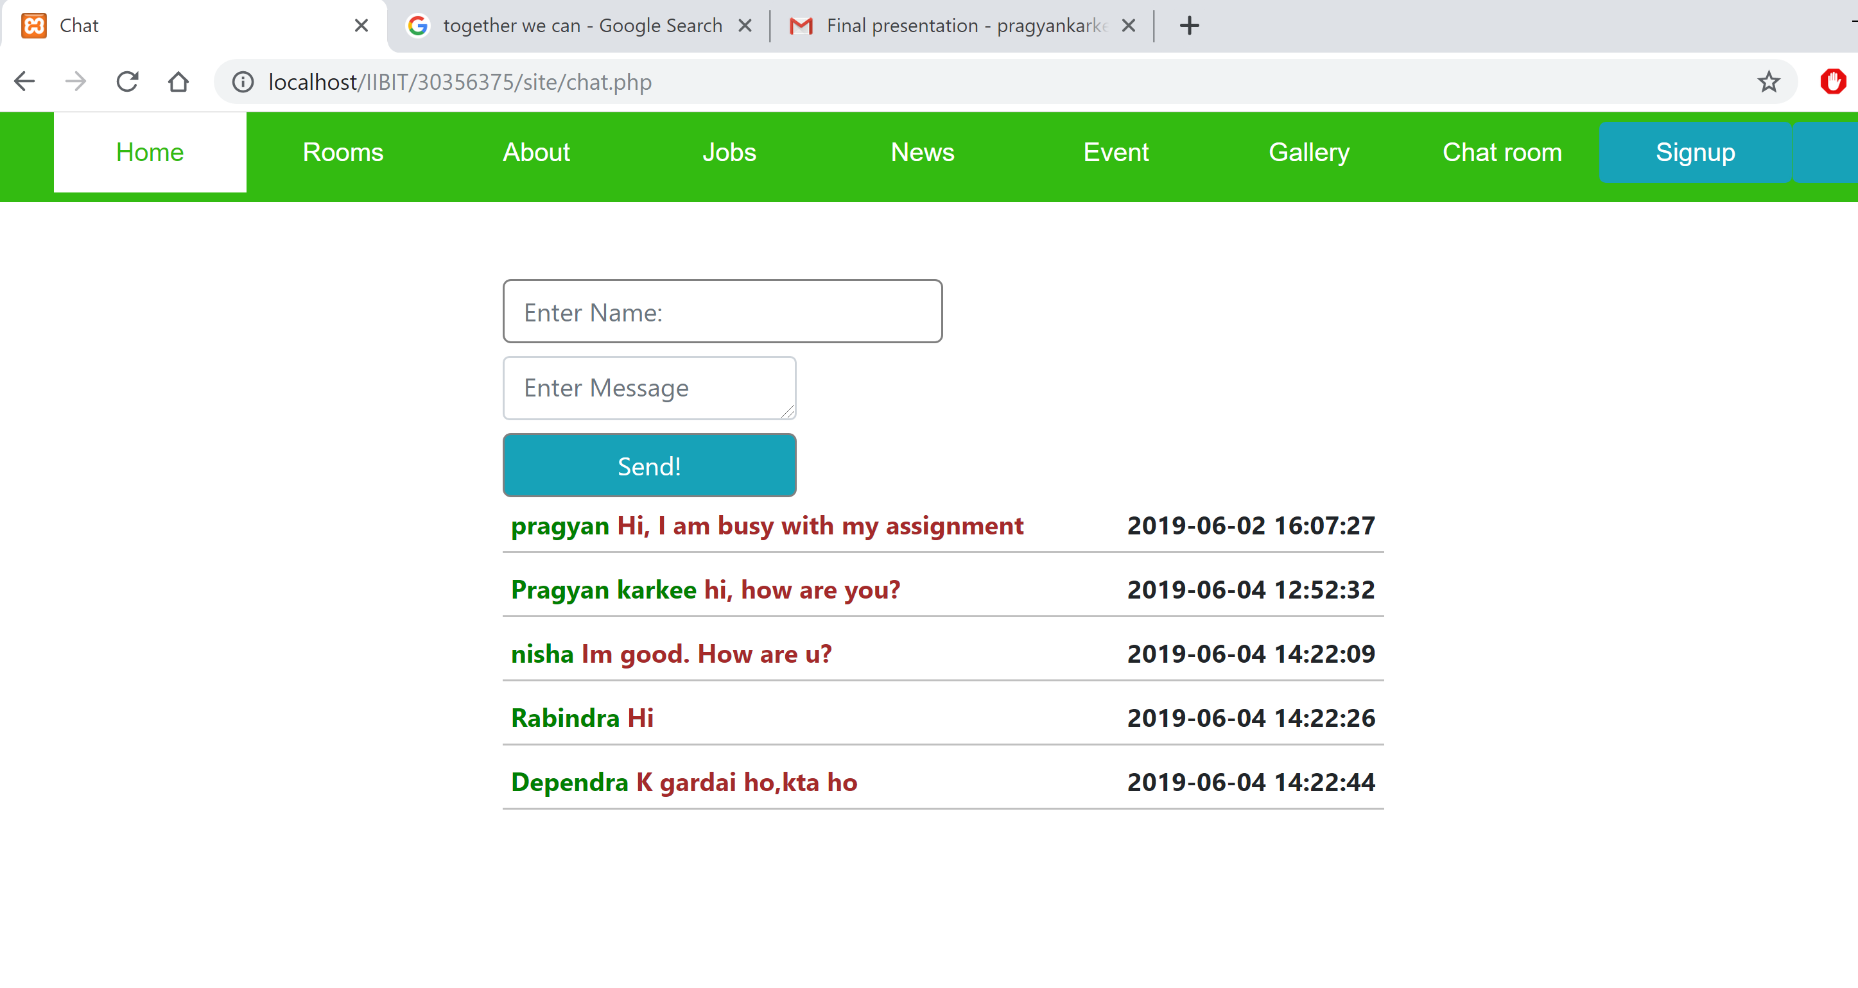
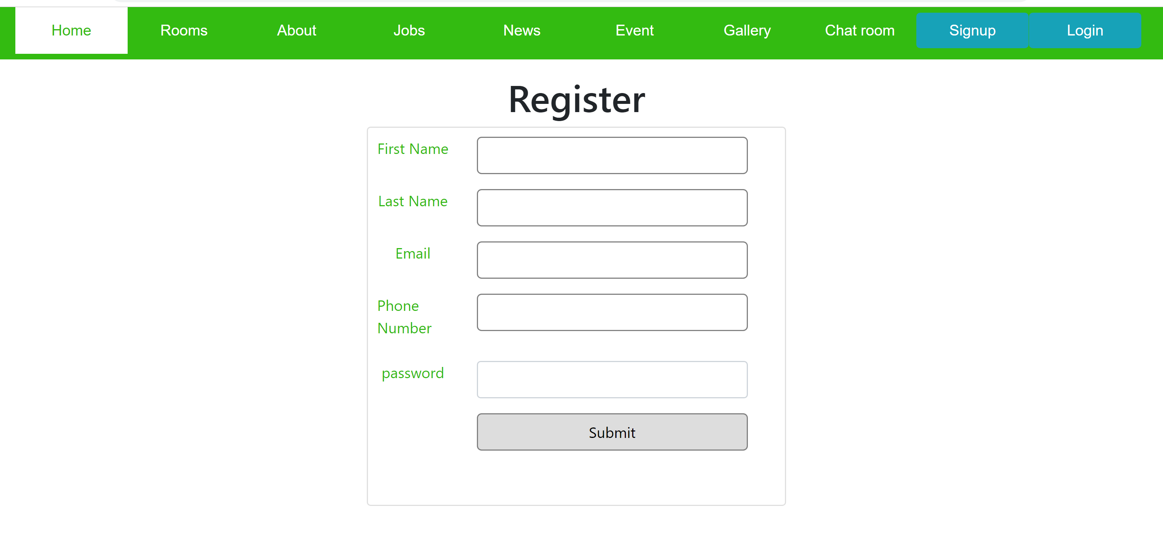
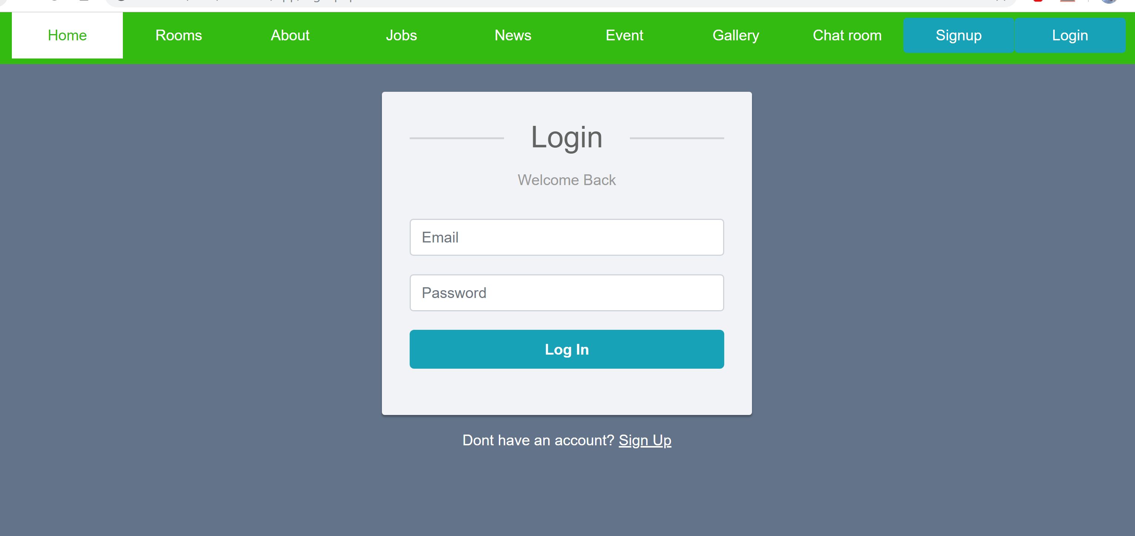
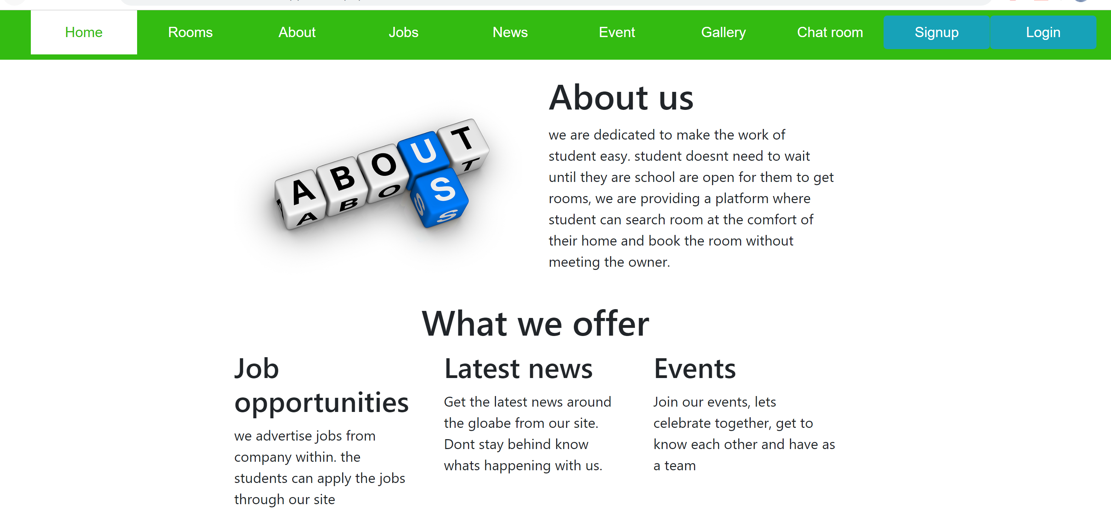
Website Demonstration – Iteration 1&2

Slide 10
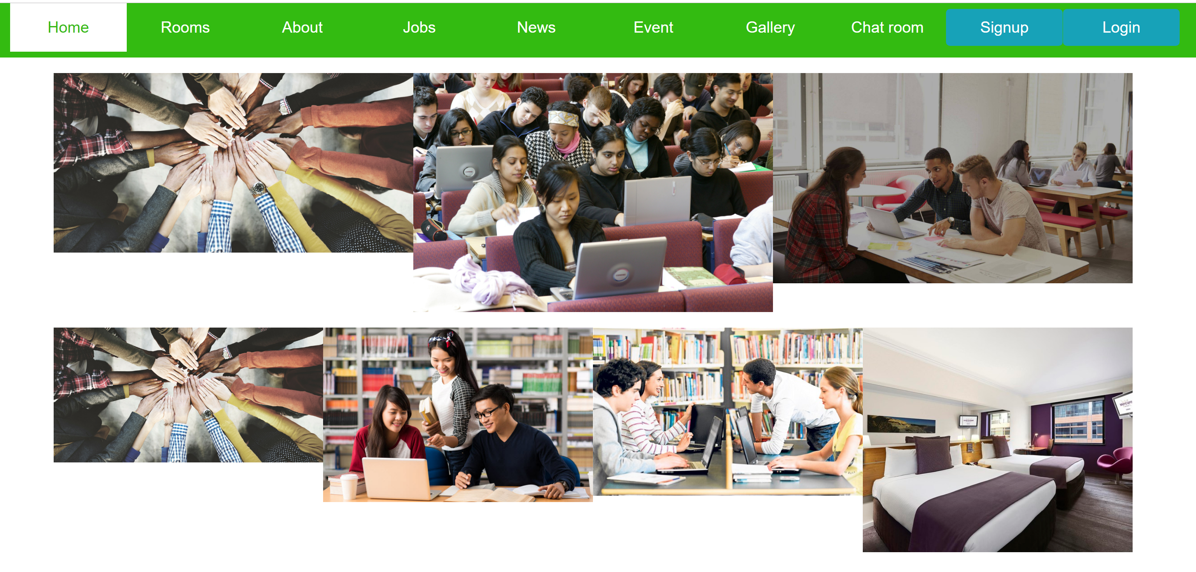
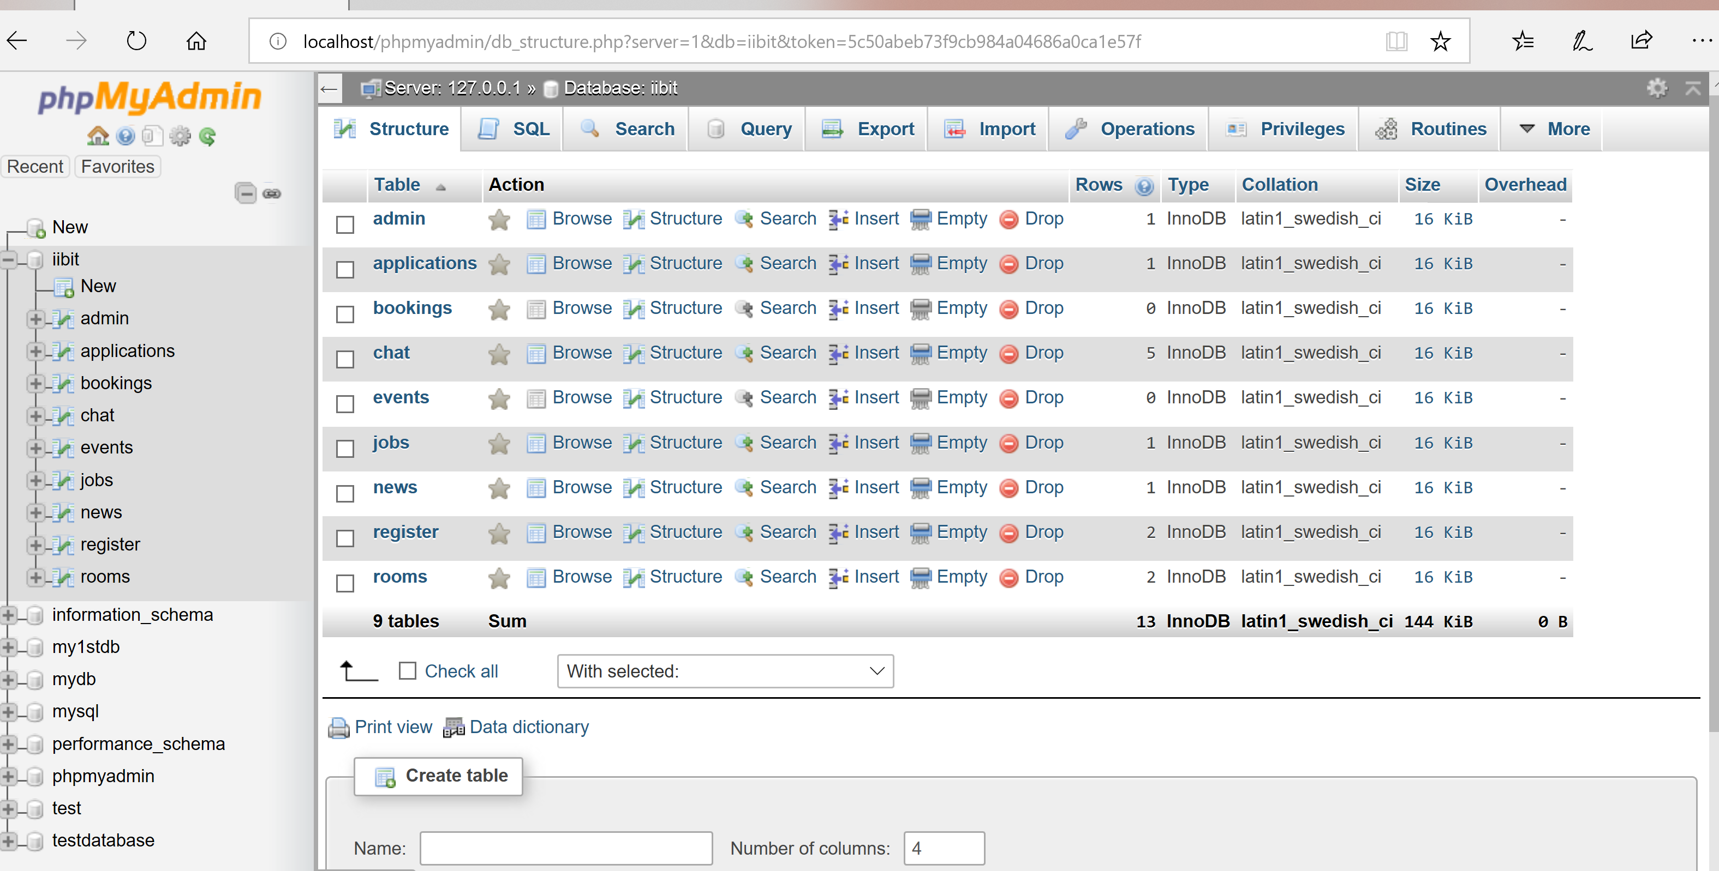
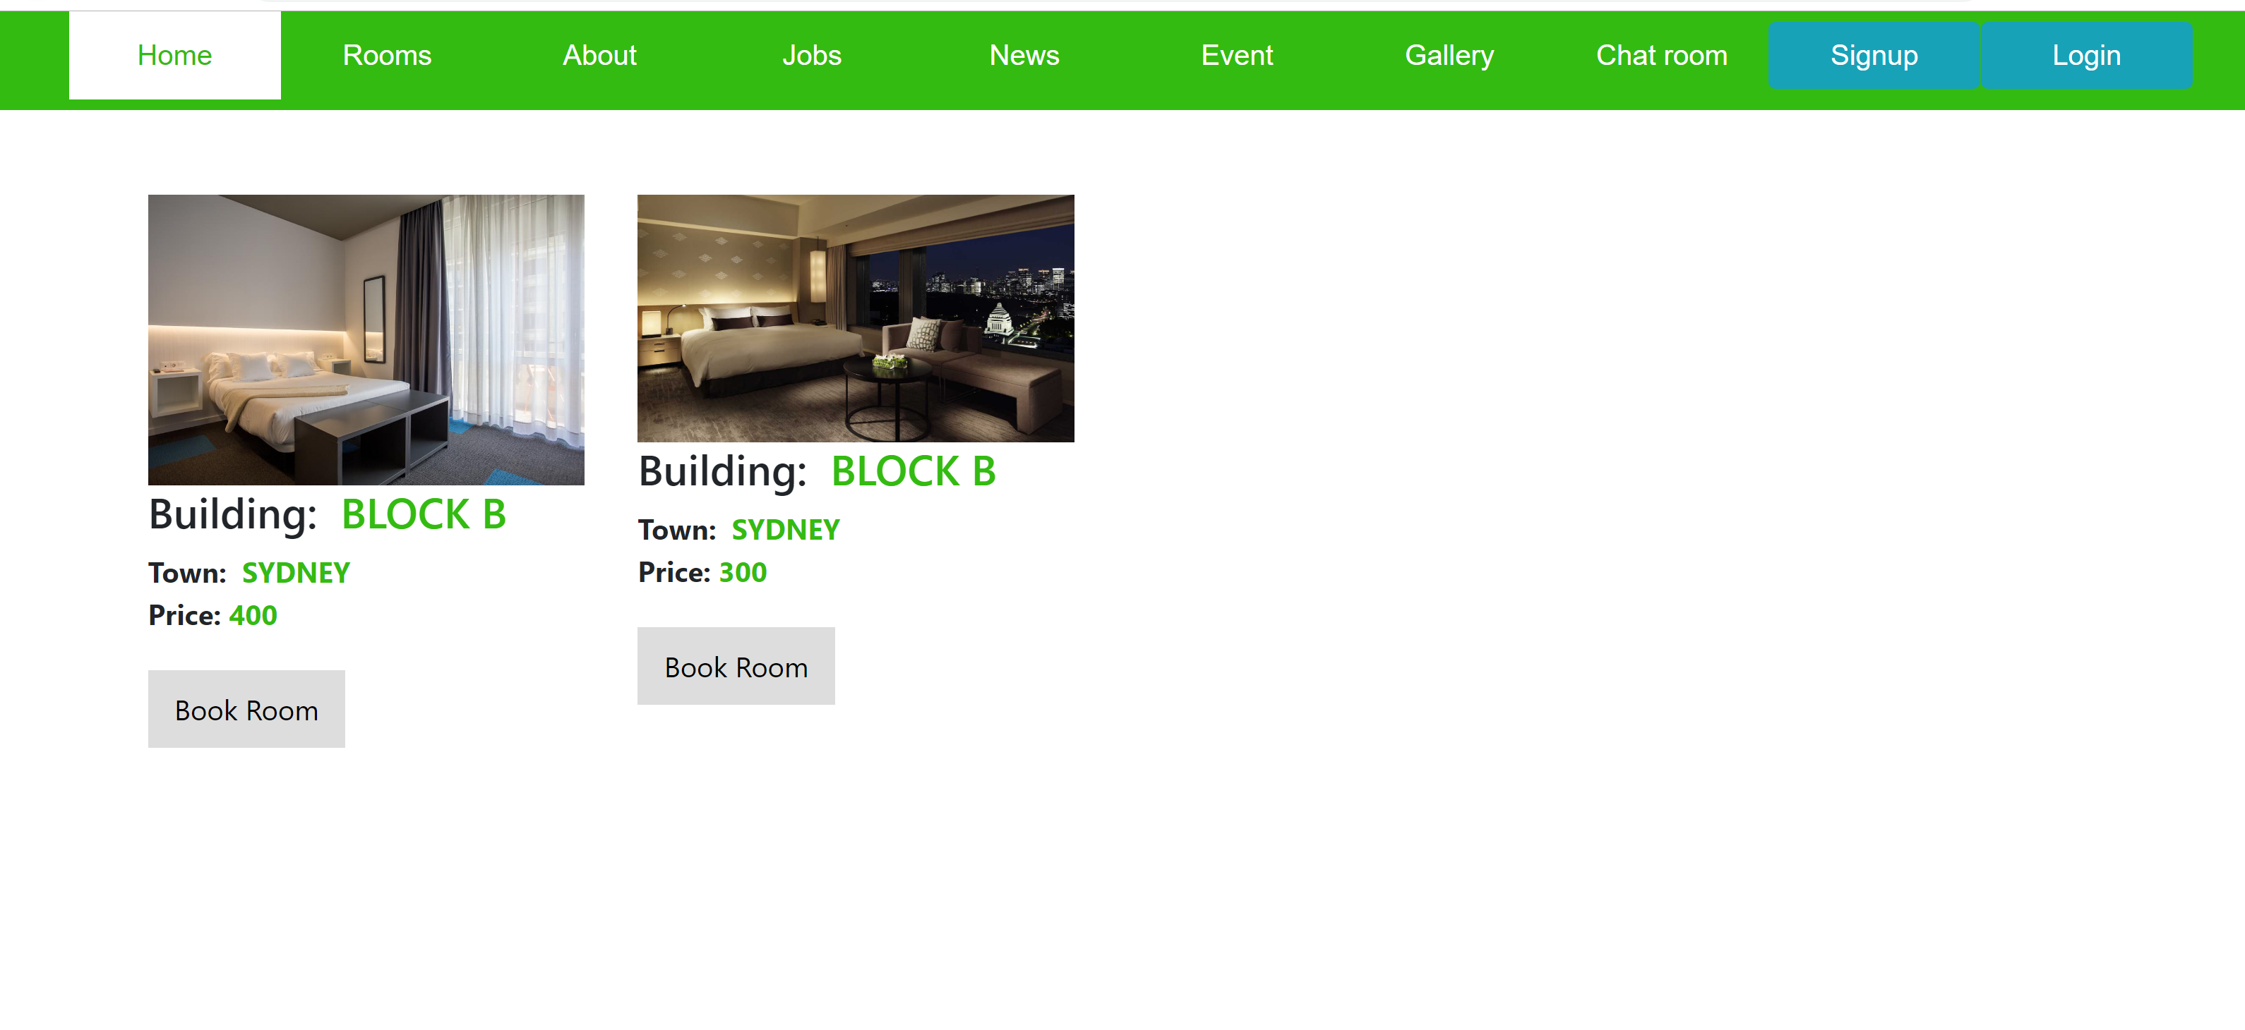

Slide 11
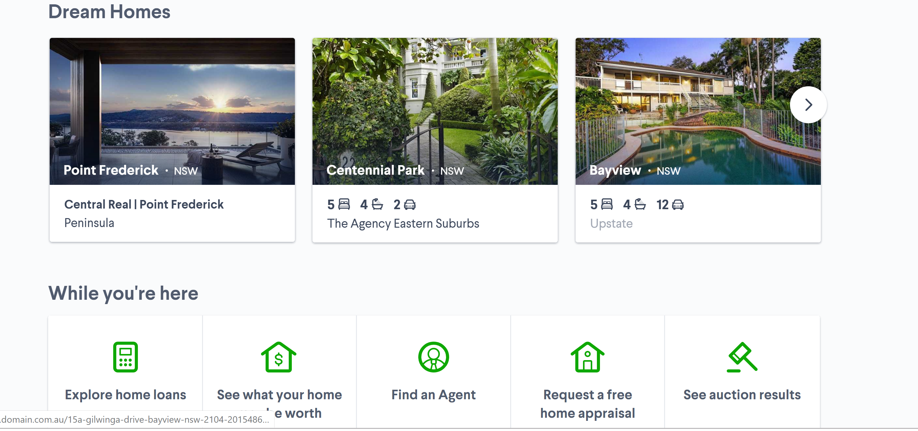
Iteration 3
US1 As a user, I want renting or sharing rooms near stations or bus stops so that I can have affordable living and nearby suburbs.

Slide 12
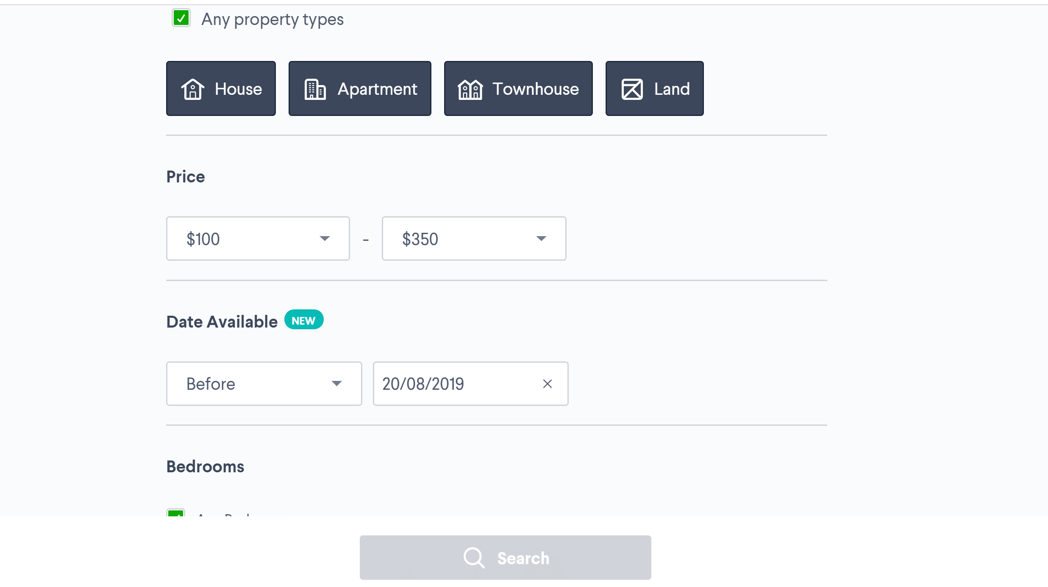
US2 As a user, I want an information about of cost of living and budgeting so that I can spend less and save little bit of money for my expenses/fees.

Slide 13

US3 As a user, I want to have a good healthcare and insurance information and details/ nearby addresses so that whenever I got sick or have any serious issues with health I can immediately go for treatment.

Slide 14
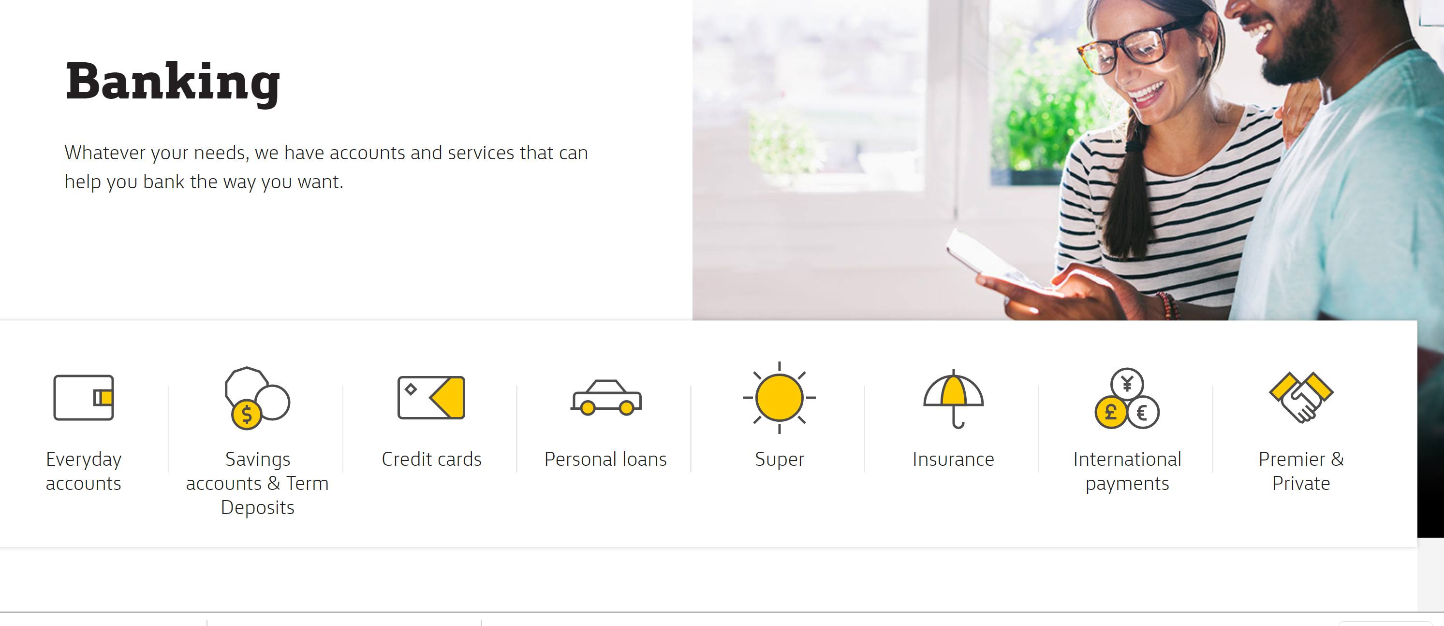
US9 As a user, I want to receive some information about creating bank account, tax file number for the new starters.

Slide 15
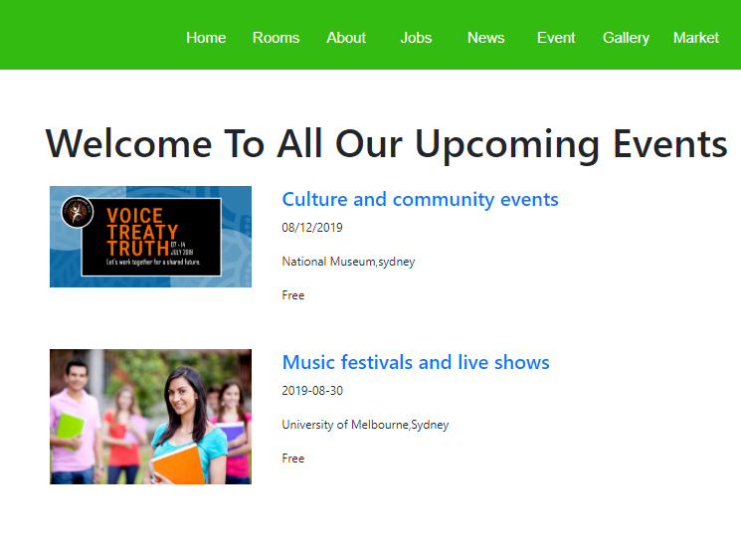
US10 As a user, I want to be a part of social activities organized nearby so that I can be engaged with international cultural activities and have some entertainment with different cultural groups.

Slide 16
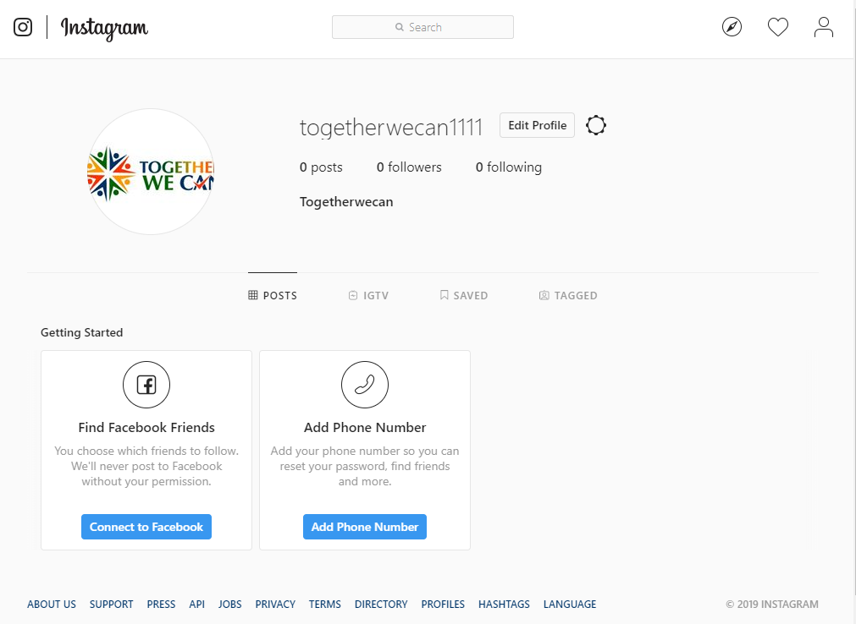
Website review

Slide 17
Critical reflection
What went well?
The users demo went well.
The users was happy with the designing.
All the team member deliver their task well.
The team finished our project handbook task on time as expected.
The development team found the engagement in project handbook work was good and responsible
What is not in our control?
The compatibility of the software is not known to the development team until the installation is made.
Absence in class.
Errors occurred while using codes.

Slide 18
Conclusion
We have discussed 2 sprints in our previous semester so we are discussing sprint 3 and so on.
As we are still working on this project so we will be completing rest of the sprints in this semester.
We will make sure that our project will work smoothly.

Slide 19
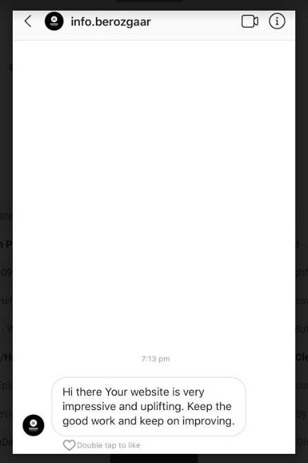
Client feedback

Slide 20
Any Question?
Thank you!!

